Slide 1


Slide 2
Software Project Scheduling
By: Amina Mustansir

Slide 3
Project Planning basics
A "Project" is a set of activities which ends with specific accomplishment and which has (1) Non-routine tasks, (2) Distinct start/finish dates, and (3) Resource constraints (time/money/people/equipment).
"Tasks" are activities which must be completed to achieve project goal.
"Milestones" are important checkpoints or interim goals for a project.

Slide 4
A “work breakdown statement (WBS)” is a categorized list of tasks with an estimate of resources required to complete the task.
WBS # | Task Description | Duration | Resources
5 | Requirements Gathering
5.1 | Understanding Problem Scope | 2 | John
5.2 | Requirements Analysis | 4 | Peter
5.3 | Develop Prototype | 3 | Fred

Slide 5
Approaches to building the
WBS
Noun-Type approaches: Projects that involve building products.
Verb-Type approaches: Projects which involve certain types of methodology
e.g. Software development involves SDLC.

Slide 6
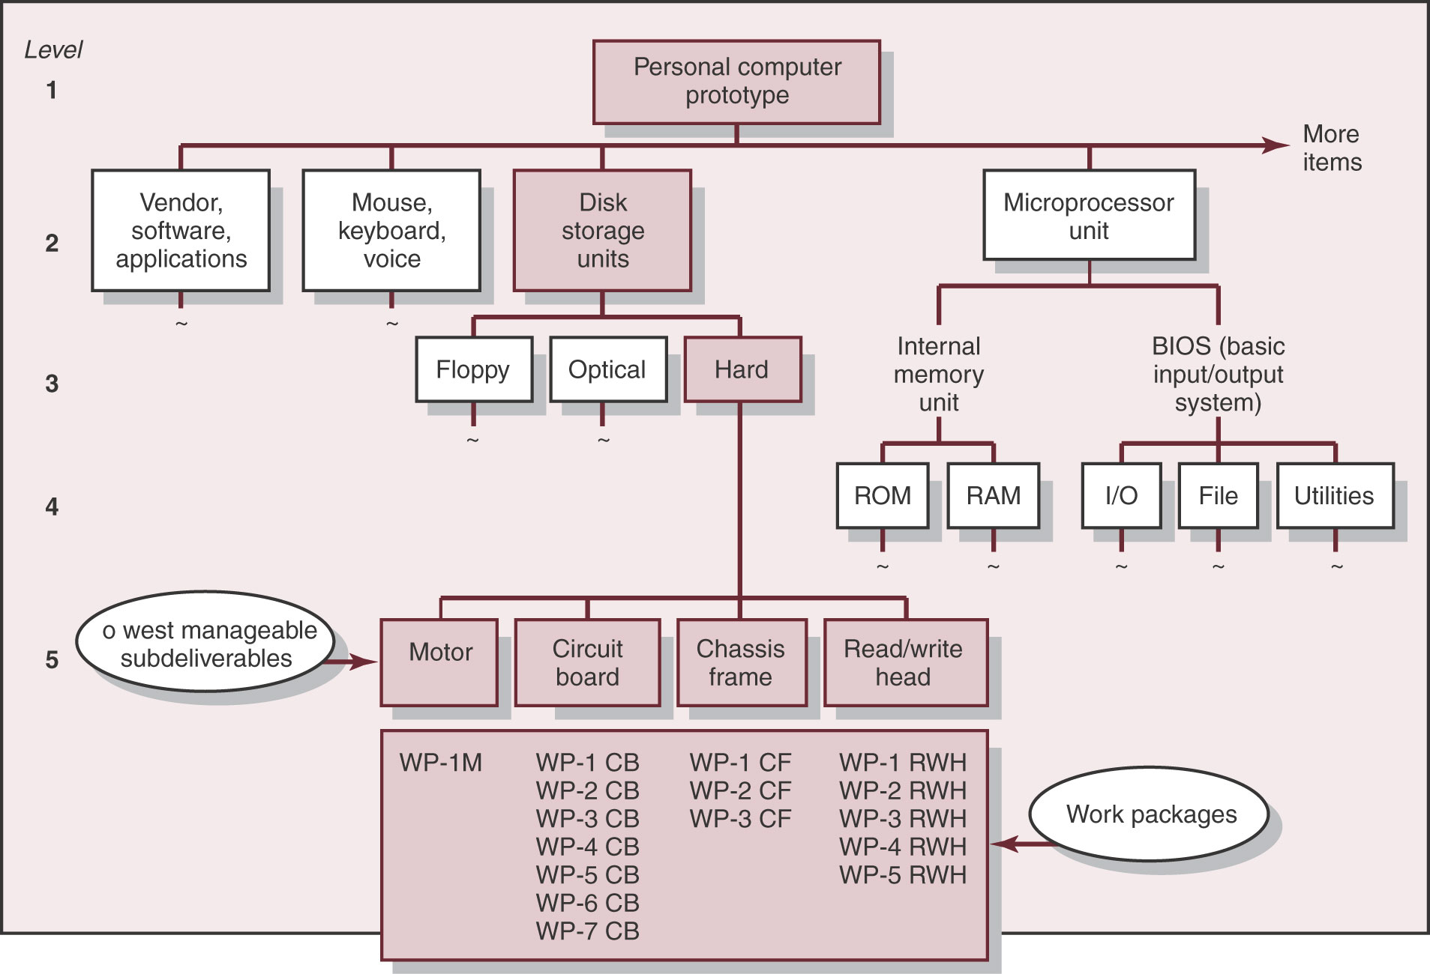

Slide 7
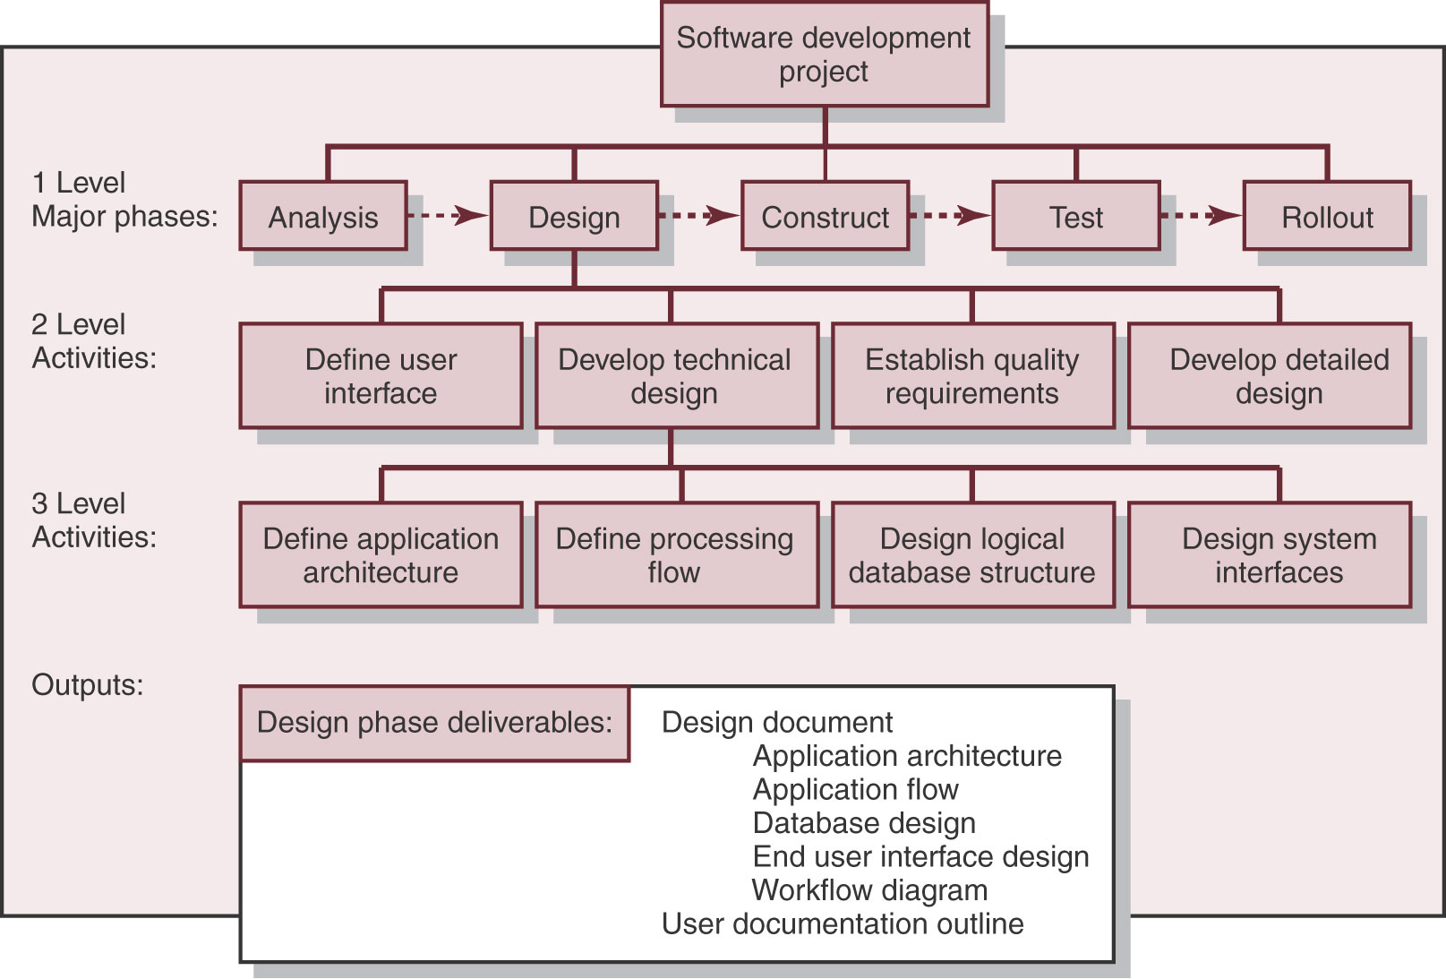

Slide 8
Typical activities when building a house
Surveying
Request Permits
Buy Material
Lay foundation
Build Outside Wall
Install Exterior Plumbing
Install Exterior Electrical
Install Interior Plumbing
Install Interior Electrical
Install Wallboard
Paint Interior
Install Interior Doors
Install Floor
Install Roof
Install Exterior Doors
Paint Exterior
Install Exterior Siding

Slide 9
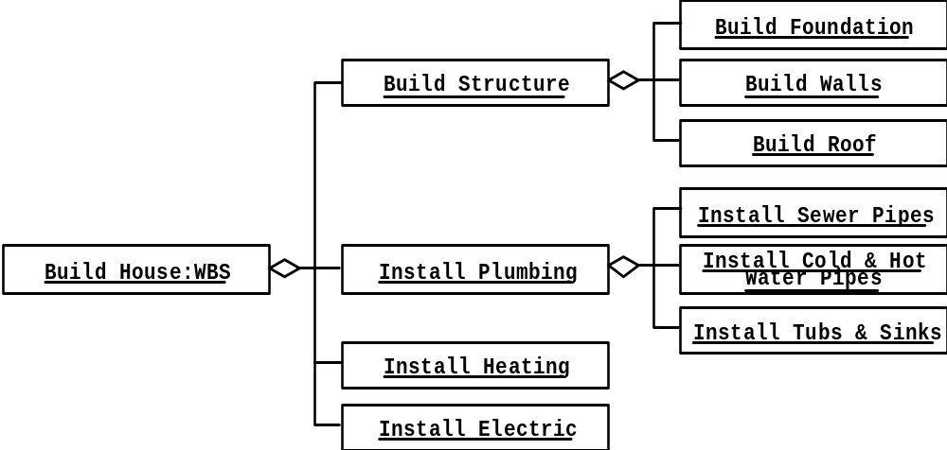

Slide 10
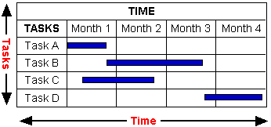
Introduction
A Gantt chart is a graphical representation of the duration of tasks against the progression of time
Gantt charts are bar graphs that help plan and monitor project development or resource allocation on a horizontal time scale.

Slide 11
Gantt Charts are useful tools for planning and scheduling projects
    Gantt charts allow you to assess how long a project should take.
    Gantt charts lay out the order in which tasks need to be carried out.
    Gantt charts help manage the dependencies between tasks.
    Gantt charts determine the resources needed

Slide 12
Gantt charts are useful tools when a project is under way.
    Gantt charts monitor progress. You can immediately see what should have been achieved at a point in time.
    Gantt charts allow you to see how remedial action may bring the project back on course.

Slide 13
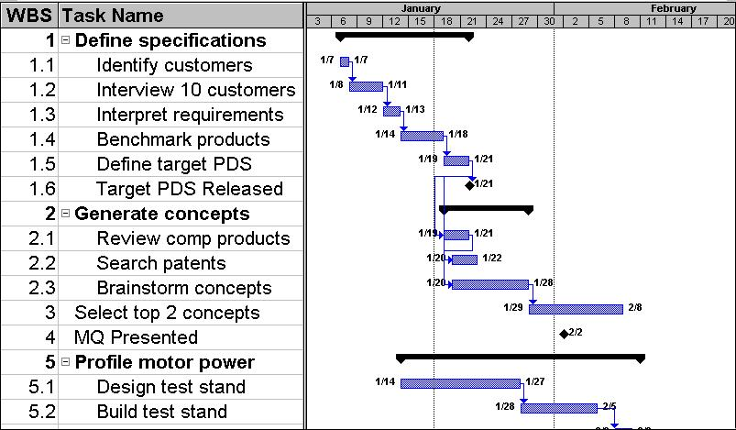
Gantt Chart view in MS Project

Slide 14
Critical Path Method (CPM)

Slide 15
Introduction
CPM is a Project Management’s technique that analyzes which activities have the least amount of scheduling flexibility (i.e., the most mission-critical)
Then predicts project duration schedule based on the activities that fall along the “critical path.”
Activities that lie along the critical path cannot be delayed.
Activities are "critical," meaning that they have to be done on time or else the whole project will take longer

Slide 16
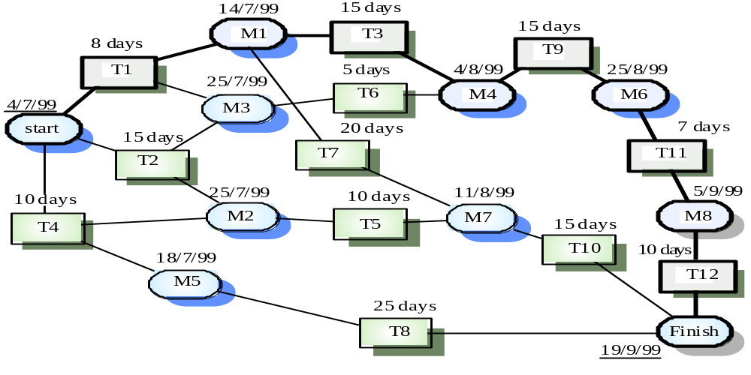
CPM provides the following benefits:
Provides a graphical view of the project.
Predicts the time required to complete the project.
Shows which activities are critical to maintaining the schedule and which are not.

Slide 17
Approaches
Two approaches are used for the critical path method:
Activity On Node (AON)
Activity On Arrow (AOA)

Slide 18
Activity On Node (AON)
It models the activities and events of a project as a network. Activities are depicted as nodes on the network and events that signify the beginning or ending of activities are depicted as arcs or lines between the nodes.

Slide 19
Steps in CPM Project Planning
Specify the individual activities.
Determine the sequence of those activities.
Draw a network diagram.
Estimate the completion time for each activity.
Identify the critical path (longest path through the network)
Update the CPM diagram as the project progresses.

Slide 20
Definitions
The critical path can be identified by determining the following four parameters for each activity:
ES_{ij} = early start time: the earliest time activity (i,j) can start without violating any precedence relations
EFi_{j} = early finish time: the earliest time activity (i,j) can finish without violating any precedence relations
LSij = late start time: the latest time activity (i,j) can start without delaying the completion of the project
LFij = late finish time: the latest time activity (i, j) can finish without delaying the completion of the project

Slide 21
Formulae
ES (K)= max [EF(J) : J is an immediate predecessor of K]
EF (K)= ES (K) + Dur (K)
LF (K)= min [LS(J) : J is a successor of K]
LS (K)= LF(K) – Dur (K)

Slide 22
Example
Activity | Immediate Predecessor | Duration (weeks)
A | ---- | 5
B | ---- | 3
C | A | 8
D | A,B | 7
E | ---- | 7
F | C,E,D | 4
G | F | 5

Slide 23
Network Diagram
ES=0
EF=5
LF=5
LS=0
ES=5
EF=13
LF=13
LS=5
A
C
ES=0
EF=0
LF=0
LS=0
ES=5
EF=12
LF=13
LS=6
ES=17
EF=22
LF=22
LS=17
ES=22
EF=22
ES=22
LS=22
ES=0
EF=3
LF=6
LS=3
Start
B
D
F
G
End
ES=13
EF=17
LF=17
LS=13
E
ES=0
EF=7
LF=13
LS=6

Slide 24
Slacks
The slack time for an activity is the time between its earliest and latest start time, or between its earliest and latest finish time.
Slack is the amount of time that an activity can be delayed past its earliest start or earliest finish without delaying the project.
Critical activities do not have any Slack

Slide 25
TS = Total Slack: the time that the completion of an activity can be delayed without delaying the end of the project
FS = Free Slack: the time that an activity can be delayed without delaying both the start of any succeeding activity and the end of the project
TS (K)= LS(K) – ES(K)
FS (K)= min [ES(J) : J is successor of K] – EF(K)

Slide 26
Summary
Activity | Dur | ES | EF | LF | LS | TS | FS
A | 5 | 0 | 5 | 5 | 0 | 0 | 0
B | 3 | 0 | 3 | 6 | 3 | 3 | 2
C | 8 | 5 | 13 | 13 | 5 | 0 | 0
D | 7 | 5 | 12 | 13 | 6 | 1 | 1
E | 7 | 0 | 7 | 13 | 6 | 6 | 6
F | 4 | 13 | 17 | 17 | 13 | 0 | 0
G | 5 | 17 | 22 | 22 | 17 | 0 | 0
The Critical Path is:
A C F G

Slide 27
Class Exercise
Activity
Predecessor
Duration
A
none
2 days
B
A
1 day
C
B
1 day
D
C
4 days
E
C
3 days
F
D,E
1 day
G
F
3 days
H
A
2 days
I
A
5 days
J
H,I
2 days
K
J,G
2 days

Slide 28
References
Handouts

